Slide 1
Impact Sourcing
Paradigm Technical Consultants, Inc.
https://paradigmtechcon.com/
214.785.7307

Slide 2
What is Impact Sourcing? Impact Sourcing is an emerging sub-field of global outsourcing. As defined by the Global Impact Sourcing Coalition (GSIC), It is an exclusive employment practice through which companies around the globe intentionally hire and provide career development opportunities to people in different geographical locations who otherwise have limited prospects for employment (those who are at the base of the pyramid), to deliver business and social outcomes. In Simple words: Impact Sourcing is a way to direct digital work towards people and areas (globally) that would not typically have opportunity to work with it and ensure they get financial stability because of it.
Paradigm Technical Consultants, Inc.
https://paradigmtechcon.com/
214.785.7307

Slide 3
Business Benefits Impact Sourcing provides many business benefits, including access to new and untapped sources of talent, higher levels of employee engagement, and lower attrition rates (as low as 40% in some cases), while also offering opportunities for employees (mostly youth) their first step onto a career ladder that leads to economic self-sufficiency through income growth, skills development, and professional advancement. Impact sourcing is often seen as a win-win strategy for business leveraging this model, outsourcing service providers and outsourcing employees.
Paradigm Technical Consultants, Inc.
https://paradigmtechcon.com/
214.785.7307

Slide 4
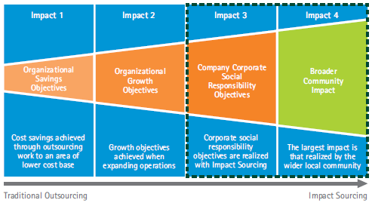
Value Proposition Based on several researches done by different organizations, the value proposition for Impact Sourcing is strong: It’s benefits are realized by those most in need, and to surrounding communities. The additive nature of Impact Sourcing—whereby clients have the opportunity to positively impact their internal Corporate Social Responsibility (CSR) agenda and have a greater positive impact on the broader communities on top of the typical business case for outsourcing—resonates with potential buyers of these services. The key point about Impact Sourcing for an outsourcing service provider and a client is that, like any traditional outsourcing service, it must offer a good business response to a client’s desire to outsource certain functions, that could be due to lower cost, global expansion or other business reasons. Although the CSR impacts are large and of huge benefit to everyone involved, it is the business reasons (typically the cost) that initially makes Impact Sourcing attractive to many businesses.
Paradigm Technical Consultants, Inc.
https://paradigmtechcon.com/
214.785.7307
Source: Accenture. (2012). Exploring the Value Proposition for Impact Sourcing - The Buyer's Perspective: Rockefeller Foundation.

Slide 5
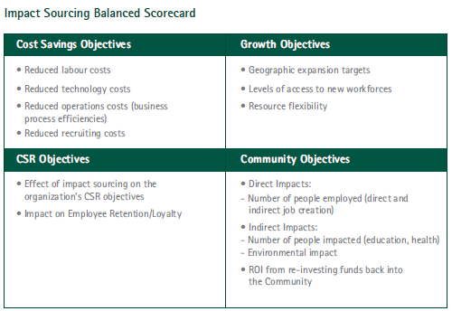
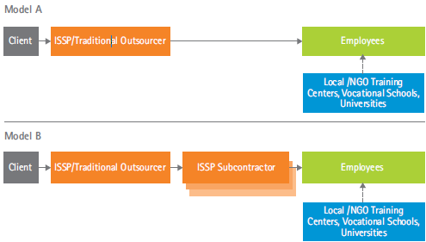
In addition to these base models there is another interim supported business model,
where external donor organizations interact
with an ISSP/traditional outsourcer,
providing the financial input that enables
the Impact Sourcing enterprise to
train local resources and provide opportunities for them to engaged on client projects. The external organizations could be non-governmental organizations
(NGOs), private or public companies,
or foundations. In some cases World bank have played this role while working closely with local governments.
Business Model
Paradigm Technical Consultants, Inc.
https://paradigmtechcon.com/
214.785.7307
Source: Accenture. (2012). Exploring the Value Proposition for Impact Sourcing - The Buyer's Perspective: Rockefeller Foundation.

Slide 6
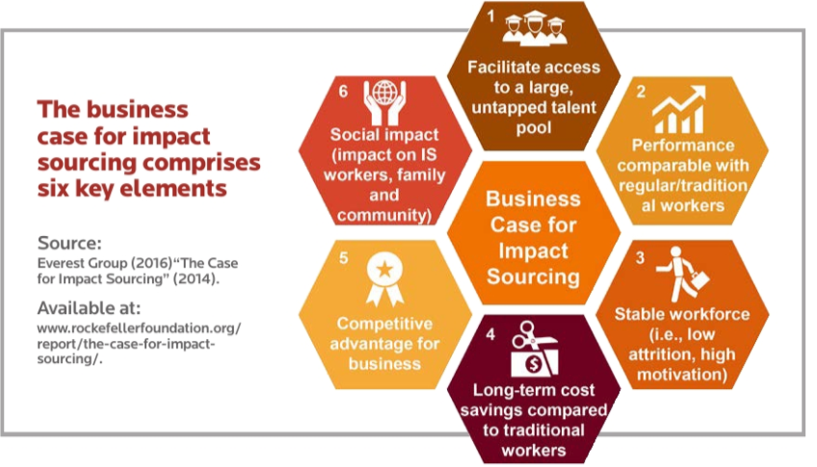
Business Case for IS Impact Sourcing (IS) initiatives are in demand by several global clients and offer significant benefits to all players involved in this process.
Paradigm Technical Consultants, Inc.
https://paradigmtechcon.com/
214.785.7307

Slide 7
The BPO sector is growing in other emerging economies with low labor costs and comparative advantages in education and language. Countries emerging as BPO locations include China, Pakistan, Vietnam, Kenya, Philippines, South Africa, Egypt, Morocco and Ghana.
Across all Impact Sourcing countries several trends and industry drivers have helped to grow this emerging field:
There is continuing pressure on corporations and some governments to deliver services in a cost-effective manner.
Recent advancements in telecommunications and reduced cost is allowing several countries to compete for BPO work and deliver quality services.
There is increasing demand for the digitization across all sectors.
There is increase in government activity around e-government initiatives and other similar projects.
Quality and levels of education are improving in many countries with high graduation rates of qualified individuals but with not enough employment opportunities mainly in high tech sector.
Paradigm Technical Consultants, Inc.
https://paradigmtechcon.com/
214.785.7307

Slide 8
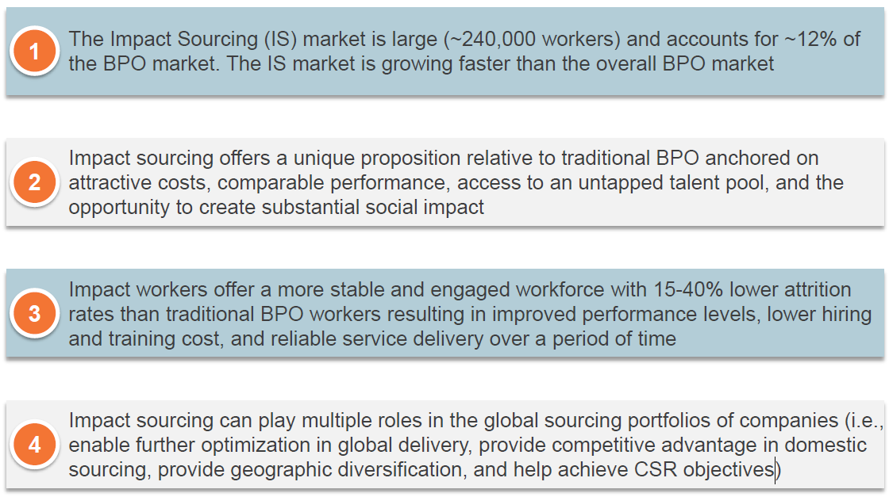
Summary
Paradigm Technical Consultants, Inc.
https://paradigmtechcon.com/
214.785.7307
Source: Everest Group; RF-The-Case-for-Impact-Sourcing-Final-approved_vf.pdf

Slide 9
Paradigm Technical Consultants is a provider of Impact Sourcing, for global information technology (IT) and business process outsourcing (BPO). Through our model we provide employment opportunities to people living at the base of the pyramid in low employment regions globally. For more information about our services for offshore and near shore and to find more details about our IS initiatives in which we are currently engaged, please contact us.
Paradigm Technical Consultants, Inc.
https://paradigmtechcon.com/
214.785.7307
info@paradigmtechcon.com

